Slide 1
Ironhack Mindfulness Podcast AI-Powered Meditation Generator
April Atkinson, Carolina Nami, Kathrin Sühlsen

Slide 2
Problem & Target Audience
Problem
Intensive learning journeys cause stress, reduced focus, and emotional overload
Solution
An AI system that automatically transforms written affirmations into guided meditation audio
Intended Audience:
Adults (25–50) who are
In intensive learning journeys — bootcamps, career transitions
Building new technical or professional skills
Seeking emotional balance during periods of growth
Using meditation as a tool for focus and resilience
The meditation tone is supportive, calm, and empowering, helping users remain centered while facing new challenges.
Use Case:
Daily mindfulness podcasts supporting focus, confidence, and resilience

Slide 3
Workflow & LLM Preprocessing
The Ironhack Mindfulness Podcast automatically transforms written affirmations or meditation notes into structured guided meditation audio.
End-to-End AI Pipeline
Input
Written affirmations or meditation scripts
LLM Processing (Preprocessing)
Transforms raw text into a structured, audio-ready guided meditation by:
  Organizing content into a clear meditation flow (1-intro, 2-opening, 3-affirmations, 4-closing)
  Adding smooth transitions
  Adjusting tone to be calm, soothing (speed: 0.75) and encouraging
  Inserting natural pauses for user to be able to repeat each affirmation
Audio Generation
Convert the structured script into calming audio using Text-to-Speech
Delivery
Playable meditation via a simple web interface
Outcome:
A fully automated meditation podcast experience.
This project demonstrates how AI can be used not only for productivity, but also for mental well-being and personal growth.

Slide 4
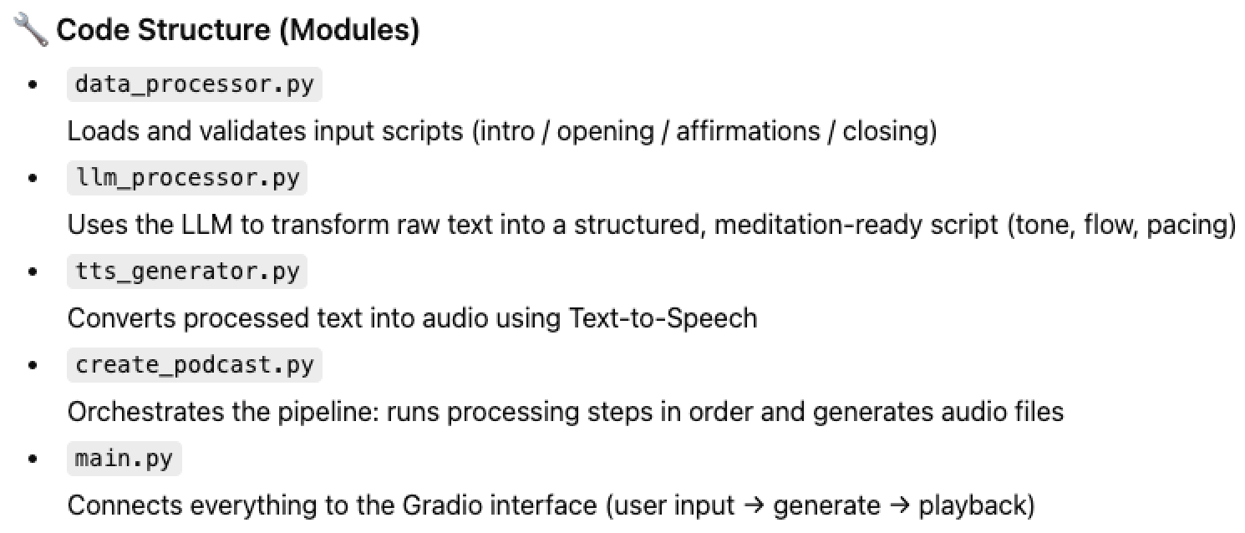
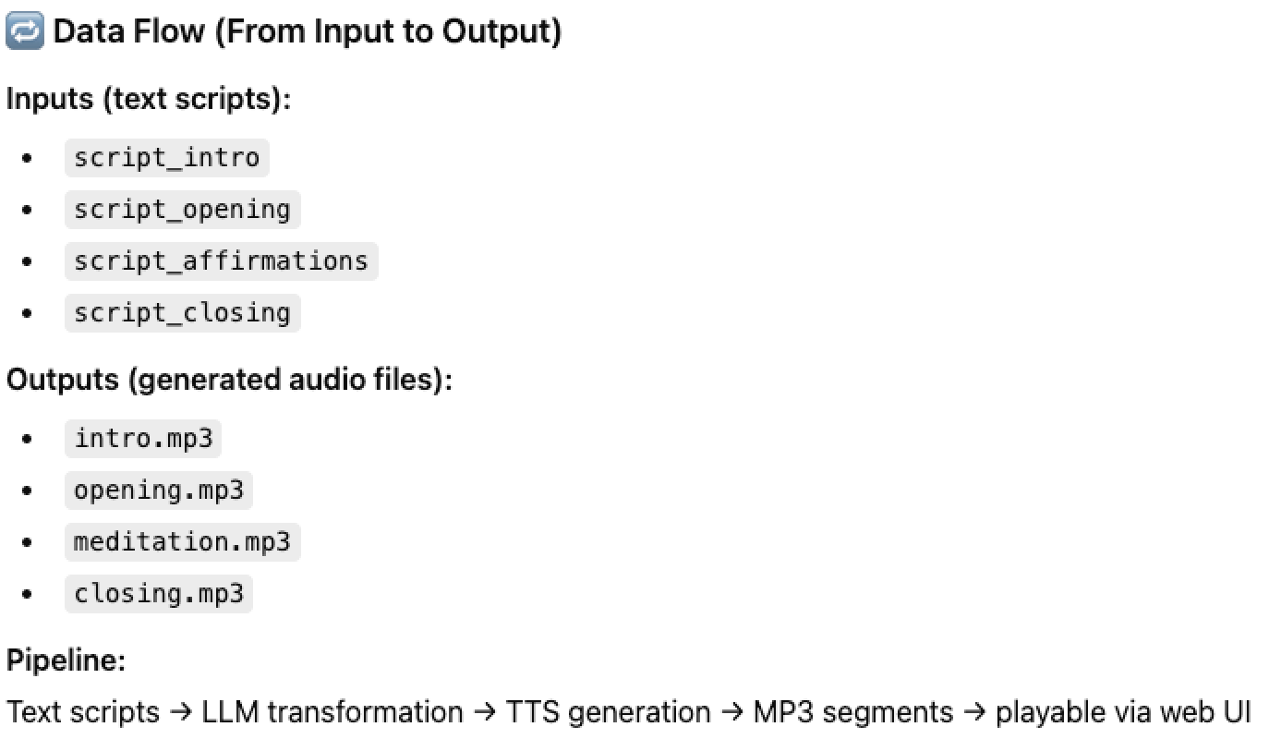
Technical Implementation
Technical Components:
Python
Open AI
  LLM for content transformation
  Text-to-Speech for audio generation
Gradio — user interface for input & playback
Git & GitHub — version control and collaboration
Code Structure & Data Flow
Data Processing Layer
  Accepts and validates text input
  Prepares data for AI processing
LLM Processing Layer
  Uses structured prompts to transform raw affirmations into guided meditation scripts
Audio Generation Layer
  Converts processed script into calming audio using TTS
Application Layer
  Connects pipeline to the Gradio interface

Slide 5
Demo, Challenges & Next Steps
DEMO LINK (Gradio)
Challenges
API Calling / Processing very buggy (e.g. not identifying the key, the files etc.)
For the voice to be soothing we needed to reduce speed to 0.75, but then it sometimes sounded too robotic
Time Constraints: Not enough time to increase the time of the pauses between affirmations (e.g. would require audio editing software), e.g. pydub. Then pydub didn’t work
Next Steps:
Voice optimization: Fine tune pauses between affirmations (make pauses longer so that listeners can repeat
Adding background meditation music
Multiple meditation themes

